Slide 1
D-110 Unit 6 Request Status, Subordinate and Support Requests
Notes:
Course: Expanded Dispatch Recorder, D-110
Unit 6: Request Status, Subordinate and Support Requests
Time: 2 Hours

Slide 2
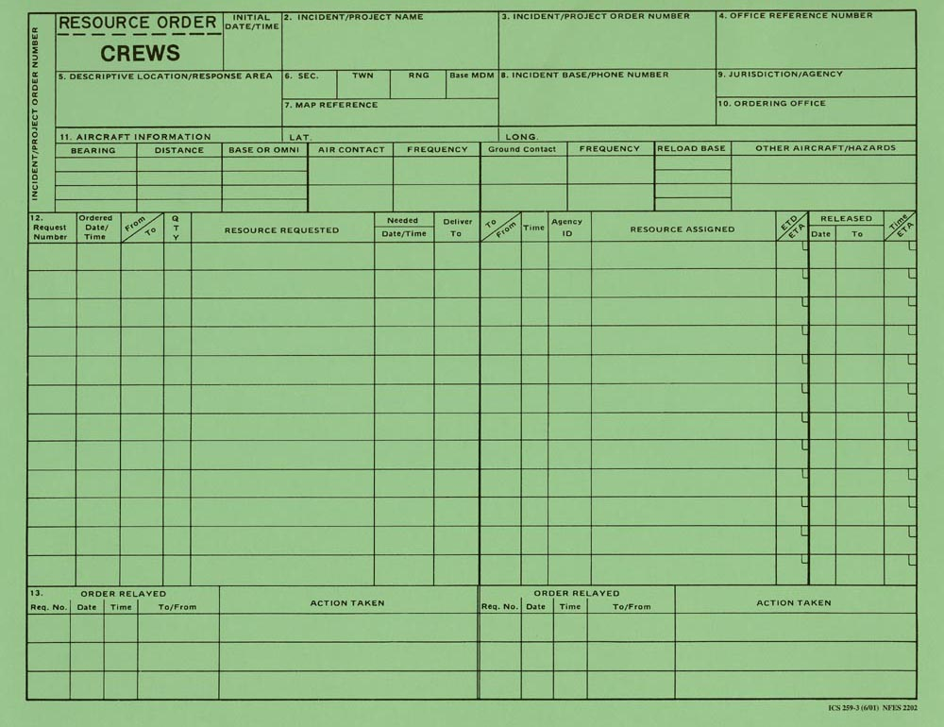
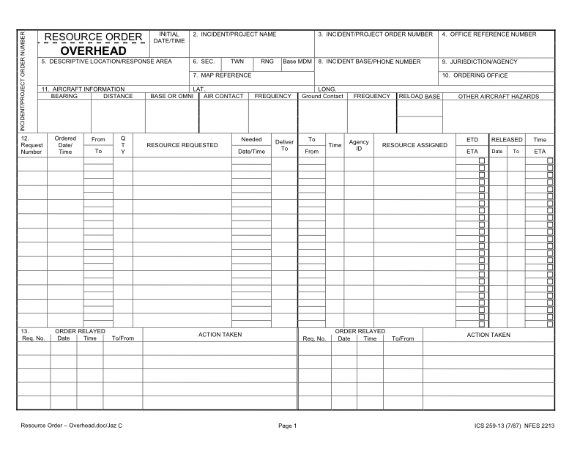
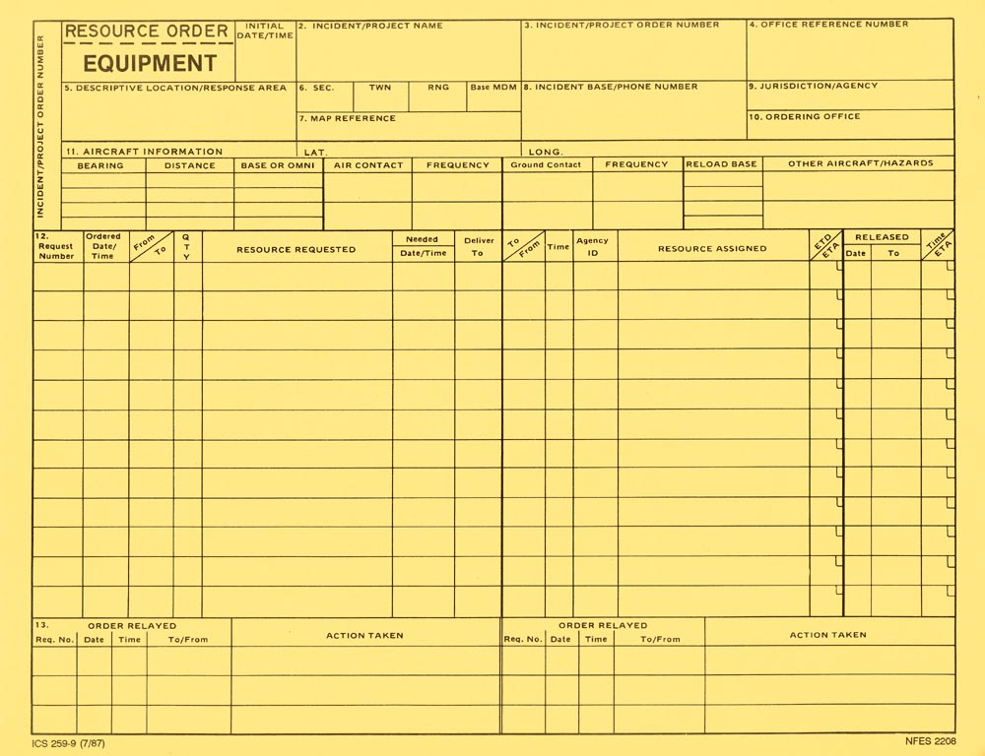
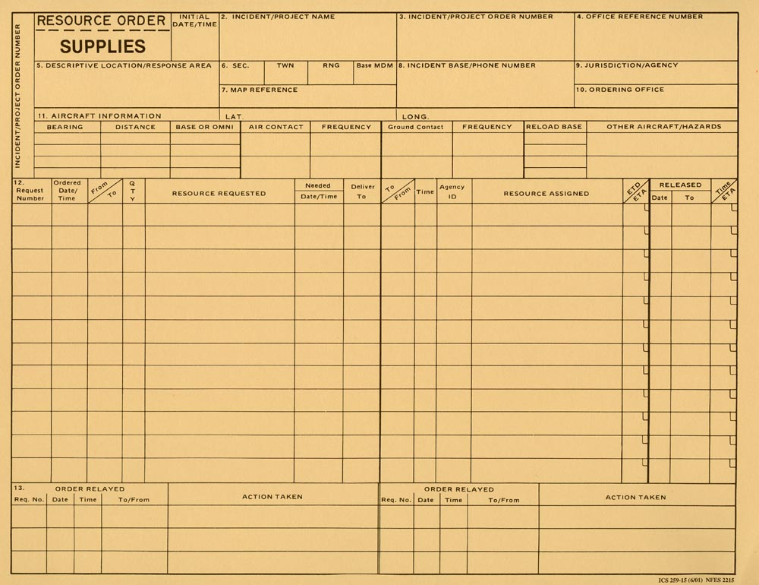
Objectives
Navigate to and describe the “Request Status” screen.
Describe the difference between support and subordinate requests.
Demonstrate the ability to utilize the “Edit Request” functionality.
Notes:
Present unit objectives
REQUEST STATUS ACTION TILE
IROC Portal
Select an incident from Watched Incident Content Selector
In the Request Status Tile List Selectors, demonstrate filter by different categories.
Local Request
Non-local
Requests by Catalog
Requests Needing Travel
Closed Incidents
By hovering over each category, it will give you a brief description of the filter criteria.
You can also click in the tile itself to select filter criteria.
This will populate the Work Area.
Selecting a request will activate the Action Buttons
Instructors note:
Demonstrate Request Status List Selectors and Action Tile Options.
Discuss the changes that occur in the Main Work Area.
Demonstrate how selecting a request by checking the box activates action buttons.
SUBORDINATE VS. SUPPORT REQUESTS
Subordinate requests
Associated with a parent request by extension.
Example: A Crew request is C-1. Crewmembers (subordinates of the crew) are C-1.1 thru C-1.20.
Support requests
One request associated with another request.
Each request may be from a different catalog item.
Example: An overhead request (DIVS, O-1) associated with a support equipment request. (Pick-up truck, E-1).
When the parent request is viewed in Accordion View, it will have a request listed as a “Child Request”
EXERCISE: 15 minutes
Purpose: Ensuring students understand the difference between subordinate and support requests.
Format: Students work independently with assistance from coaches as necessary.
Materials Needed: Laptop with Chrome and internet access
Instructions:
Have students create a support request for a bus for the T2 crew request.
Demonstrate the request has been completed.
End of Exercise.

